Slide 1
A Transaction Cost Approach to Make-or-Buy Decisions
Gordon Walker
David Weber

Slide 2
Research Question
Make-or-buy decisions are considered as a paradigmatic (or canonical) problem for analyzing transaction costs given their relevance for vertical integration.
How do supplier market competition, volume uncertainty, technological uncertainty, and comparative production costs between buyer and supplier affect the make-or-buy decision?

Slide 3
TCE and Make-or-Buy Decision
Two dimensions:
(1) the uncertainty associated with executing the transaction; and
(2)the uniqueness or specificity of the assets associated with the goods or service transacted.
Main Logic: individuals have limited information-processing capacity and are subject to potential opportunistic bargaining, high uncertainty makes it more difficult for the buyer of the goods or service to evaluate the supplier's actions (due to incomplete contracts), and high asset specificity makes opportunistic supplier decisions particularly risky for the buyer because of potential economic hold-up problems. Unilateral control over production thus reduces the buyer’s risk.

Slide 4
Literature Gap
In addition to vertical integration, this article also discusses vertical de-integration;
Asset specificity and uncertainty are joint conditions for make decisions. This study allowed to each of these variables to influence make-or-buy decisions independently;
Sufficient uncertainty was inherent in all transactions included in the study to make it very difficult for the buyer to neutralize potential supplier opportunism effectively through contingent claims contracts (Williamson, 1975: 22); Therefore, any increase in asset specificity would tend to increase transaction costs.
Because of the way that the types of uncertainty examined influenced transaction costs, it is assumed that they did so independently of the level of asset specificity.

Slide 5
Two types of uncertainty
Volume uncertainty: Fluctuations in the demand for a component and confidence placed in demand estimates. High VU imposes increased production costs and excess capacity on suppliers and excess inventory or stock outs on buyers. Increase in VU leads to increase in TC.
Technological uncertainty: Changes in component design (retooling). Increases buyer costs (re-contracting with supplier). Thus, TU increases the likelihood of a “make” decision.

Slide 6
Theory Development: Uncertainty
H1: Volume Uncertainty
+
Make
H2: Technological Uncertainty
+
-
Buyer Experience*
*Greater buyer experience, reducing technological uncertainty and thereby the risk of opportunism, should lead to the Buy decision.

Slide 7
Theory Development: Competitive Production Cost
H3: Competitiveness of Supplier Market
+
Supplier Production Cost Advantage
+
Buy
-
Buyer Experience*
*Greater buyer experience in producing should reduce the supplier’s relative production cost advantage, leading to the Make decision. This is offset, however, by the relationship between buyer experience and technological uncertainty shown in the previous slide.
The authors expect greater buyer experience to make the Buy decision more likely.

Slide 8
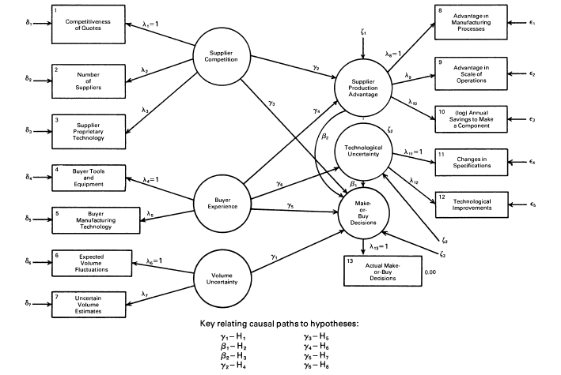
Methodology

Slide 9
Methodology
The data consisted of 60 decisions made in a component division of a large U.S. automobile manufacturer over a period of three years. The sample of 60 emerged by exception from the roughly 20,000 parts the division used for assembly.
The production of 20 components, out of 49 previously made, was shifted to the market, and four out of nine components previously bought were brought inside the firm. Two components in the sample were new.
Questionnaire? Interview? (They provide reliability measures later, but most are below 0.7).
Unweighted least squares (ULS) procedure of Joreskog and Sorbom (1982).

Slide 10
Empirical Results
Corroborated: Volume uncertainty and comparative production costs. VU receiving more attention than TU may owe to demand estimates as a priority over retooling.
Moderately Corroborated: Competitiveness of Supplier Market
Not Corroborated (i.e., Falsified): Technological Uncertainty (positive TU was associated with buy decisions), Effects of competition and Buyer Experience (NB: For an explanation of the technological uncertainty result, see Balakrishnan and Wernerfelt (1986).
Finding: Comparative production costs had a predominant influence on make-or-buy decisions over transactions costs.

Slide 11
Discussion
Empirical Problem: small sample, not random, not generalized, alternative model specifications not considered, missing variable problem. Also, common method bias given the heavy reliance on survey data.
Measurement of make-or-buy, binary or non-binary
Mixed empirical corroboration of TCE
Old good days: several hypotheses are falsified and still published
Uncertainty and Asset Specificity: joint or independent?

